Slide 1


Heritage walk and crafts corner

Slide 2
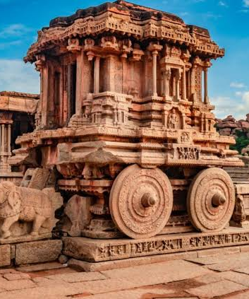
Hampi
Where Stones Tell Stories In Silence

Slide 3
Introduction
Hampi was the capital of the Vijayanagara Empire in the 14th century
Portuguese, say that Hampi was a prosperous, wealthy and grand city
City near the Tungabhadra River
numerous temples, farms and trading markets

Slide 4
Introduction
1500 CE, Hampi-Vijayanagara was the world’s second-largest medieval-era city after Beijing
Beijing-( the capital of the People’s Republic of China.)
Probably India’s richest at that time, attracting traders from Persia and Portugal
Located in Karnataka near the modern-era city of Hosapete

Slide 5
Introduction
The Ramayana and the Puranas of Hinduism as Pampaa Devi Tirtha Kshetra

Slide 6
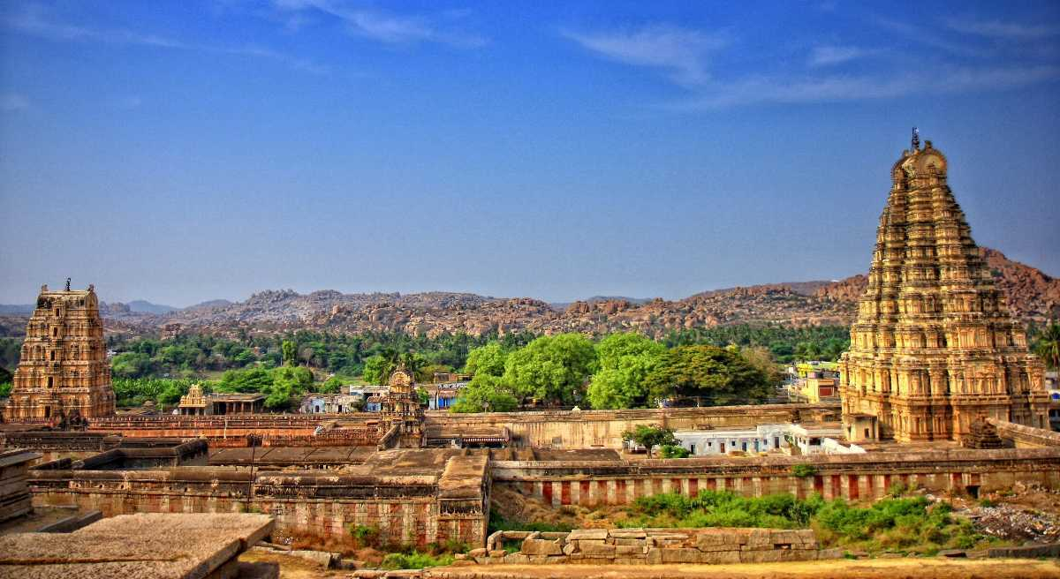
Virupaksha Temple, Hampi
Built -7th century.
UNESCO -World Heritage site.
One of the forms of Lord Shiva called Lord Virupaksha
sculptures – depict mythological stories of numerous Gods and Goddesses

Slide 7
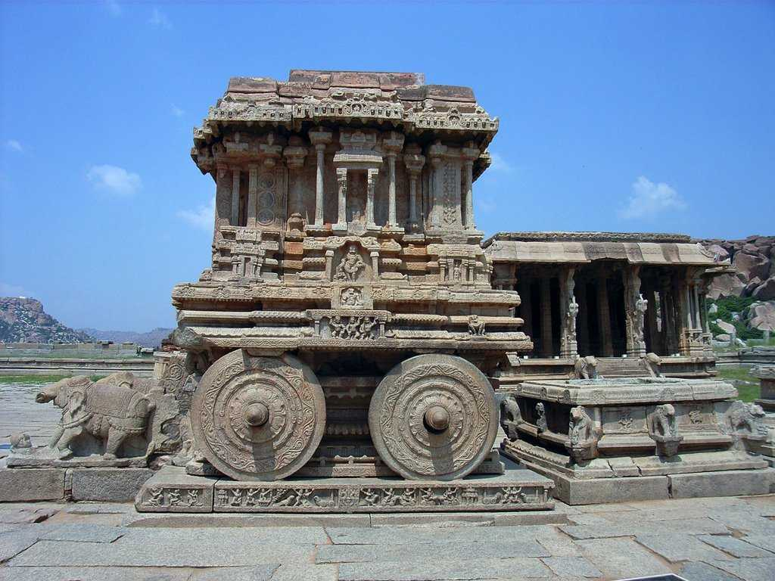
Vithala Temple
16th century
stone chariot - iconic symbol of the architecture of Hampi
Carvings on the walls/pillars of these structures depict various gods in different forms

Slide 8
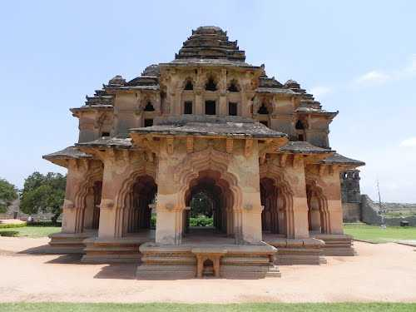
Lotus Palace
Looks like a lotus in bloom
Palace was the designated area for the royal women of the Vijayanagara Empire

Slide 9
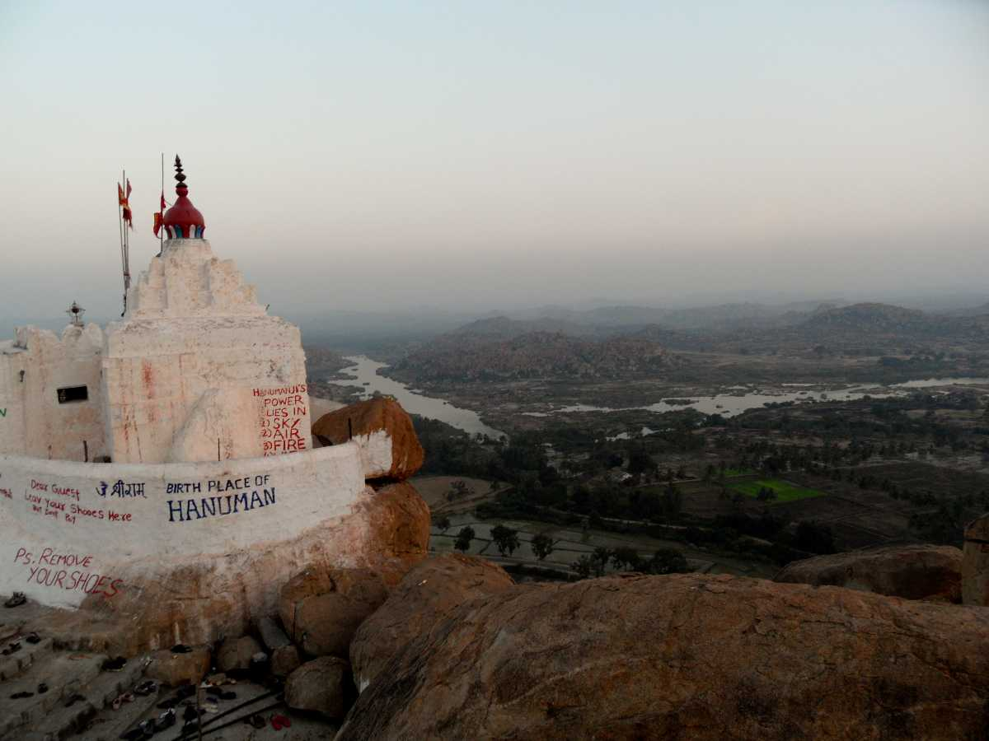
Yantrodharaka Hanuman Temple
Known as the Monkey Temple is present inside a cave
500 years old
Dedicated to Lord Hanuman
Ideal installed – Sri Vyasaraja,
who was the Rajaguru of the Vijayanagara Kingdom and a Dwaita philosopher

Slide 10
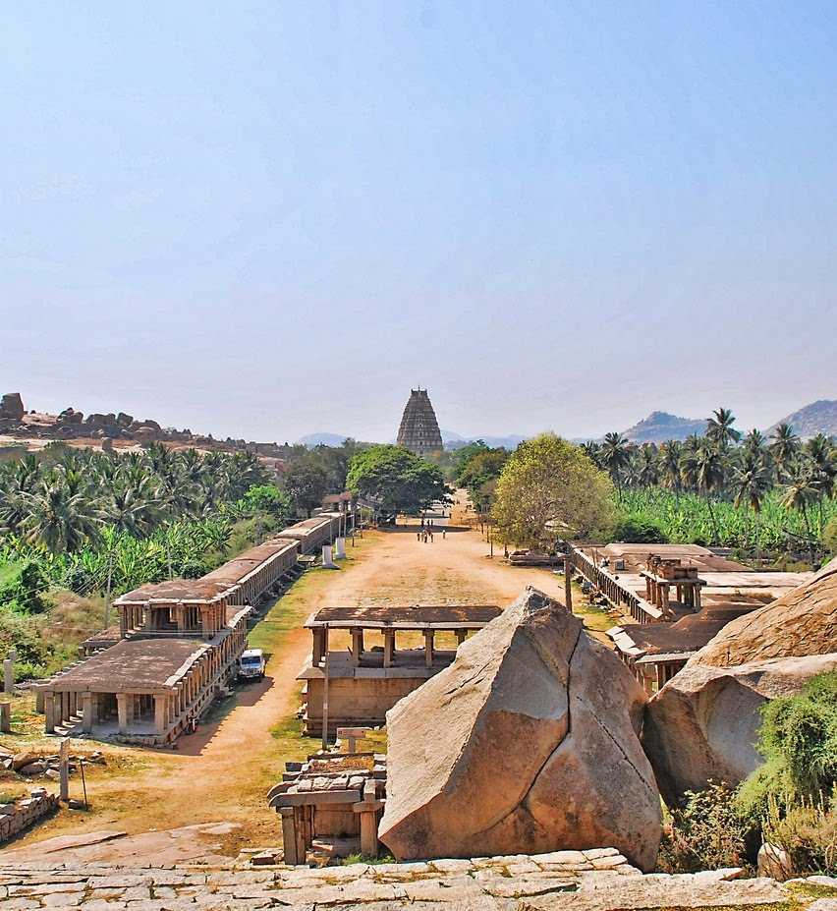
Hampi Bazaar
Also known as the Virupaksha Bazaar
Knick-knacks, souvenirs, cheap clothes and trinkets to remember your trip to Hampi

Slide 11
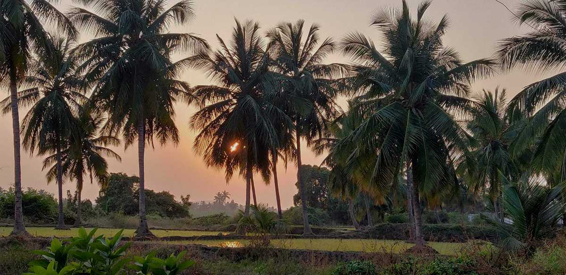
Hippie Island
Virapapur Gadde or Hippie Island
a small island situated across the Tungabhadra river
It best place to stay as there are Lodges and hotels With dilicious food

Slide 12
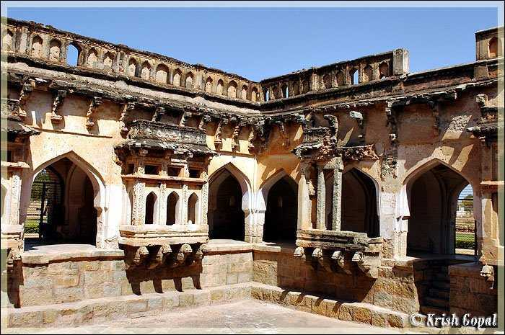
Queen’s Bath
Royal bath during the times of the Vijayanagara Empire
Over 500 years old
A notable design feature of the Royal Bath is that it has no ceiling
It was built in such a way that no outsiders

Slide 13
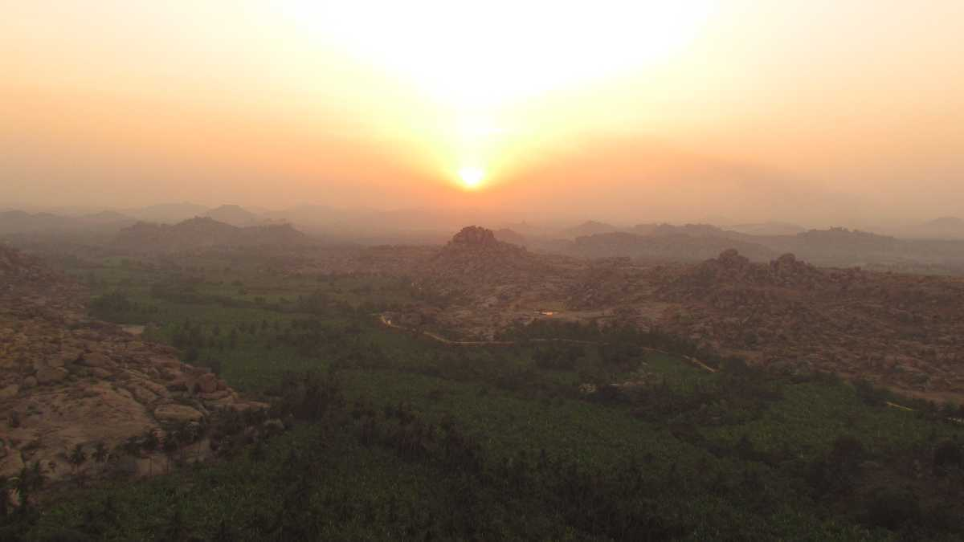
Matanga Hill, Hampi Overview
Highest point of Hampi
Best places to see a bird’s eye view of Hampi

Slide 14
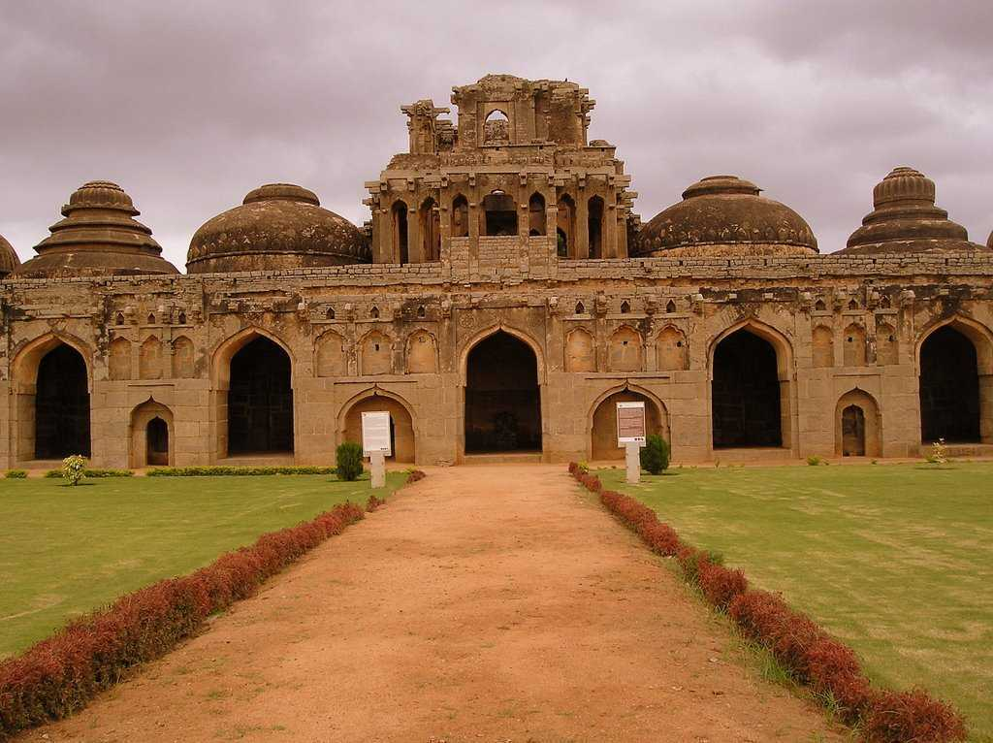
Elephant Stables
Shelters for royal elephants
Eleven domed chambers are seen here with a particularly decorated
15th century

Slide 15
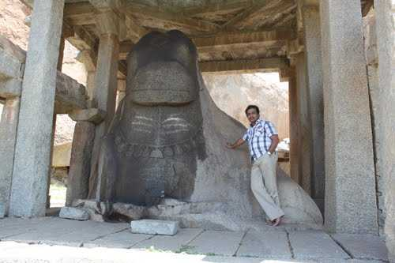
Monolith Bull

Slide 16
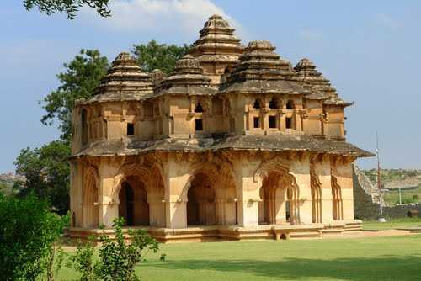
Zenana Enclosure
An area for the Queen and her cohorts
The way from Basement of the Queen’s Palace
Three guard towers that ensured that no male was allowed to enter the premises besides the king

Slide 17
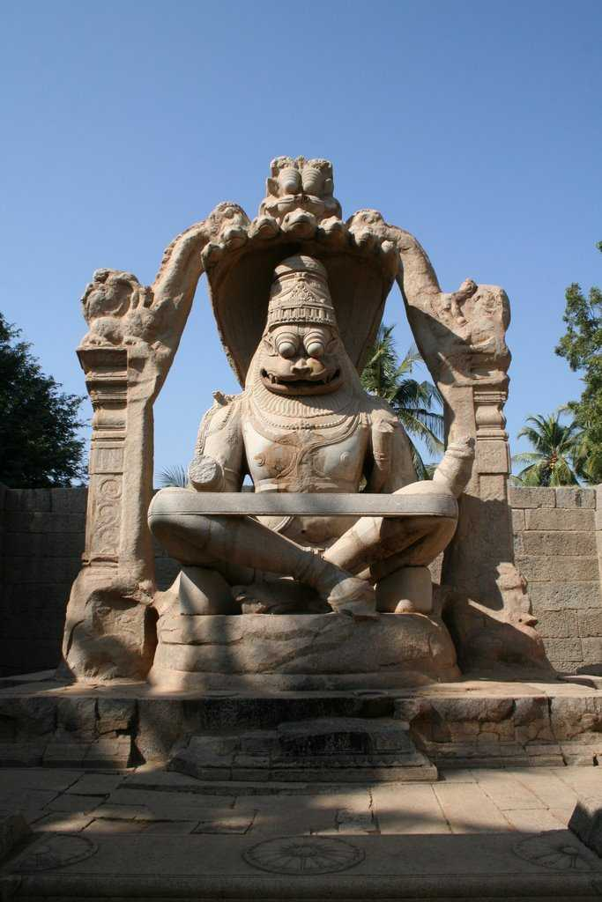
Lakshmi Narasimha Temple
Narasimha sitting on SeshaNaag i.e. the seven-headed snake acting as a shelter to him.
Biggest monolith statue in Hampi.
1528 AD
Ruler - Krishnadevaraya

Slide 18
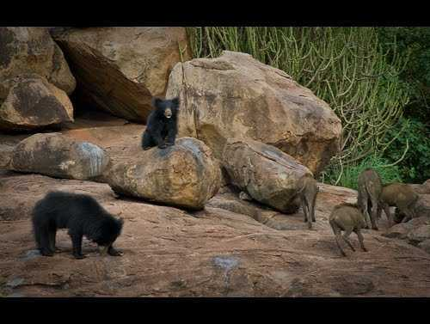
Daroji Bear Sanctuary
Conservation of these bears.
Approximately 120 sloth bears
Includes - Jackals, leopards and wild boars

Slide 19
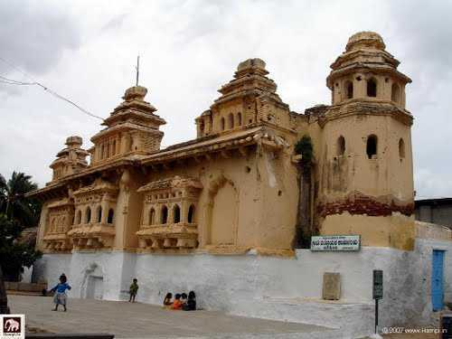
Old Palace
Also known as Gagan Palace
500+ years old
Destroyed during the Mughal raids

Slide 20
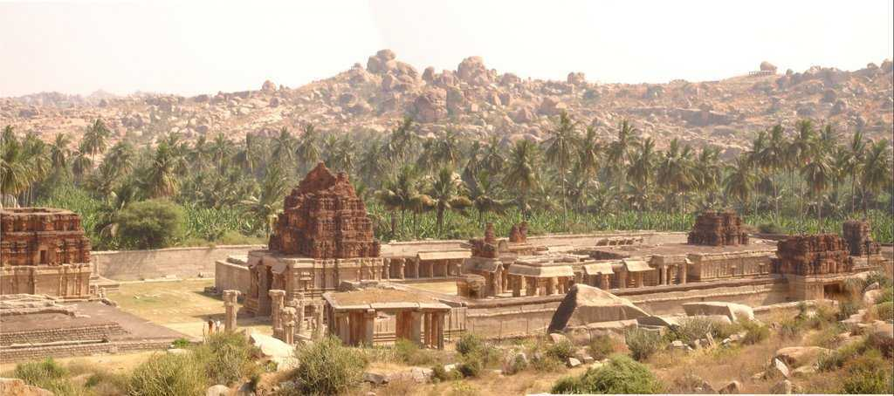
Achyutraya Temple
Also known as the Tiruvengalanatha Temple
Built in 1534 AD

Slide 21
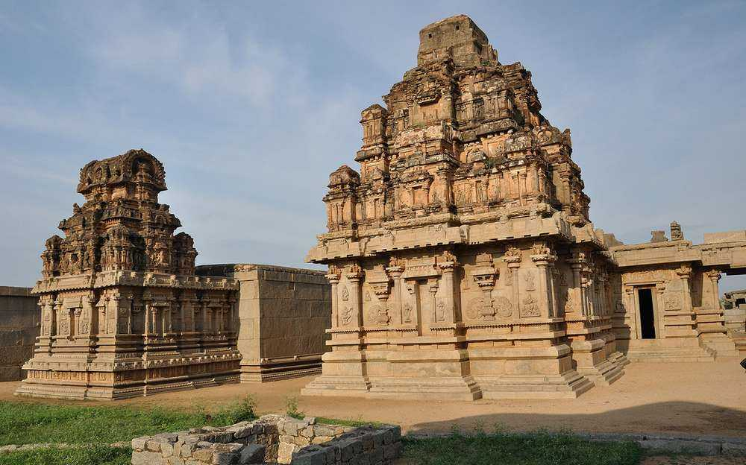
Hazara Rama Temple
Dedicated to Lord Rama
15th century
Several Bollywood and Kannada films are shooted.

Slide 22
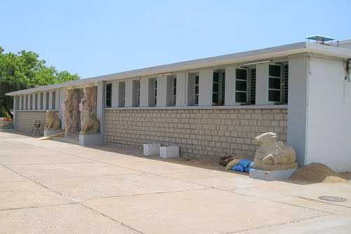
Archaeological Museum
Under taken by government
Exhibits sculptures and monument found during excavation.

Slide 23
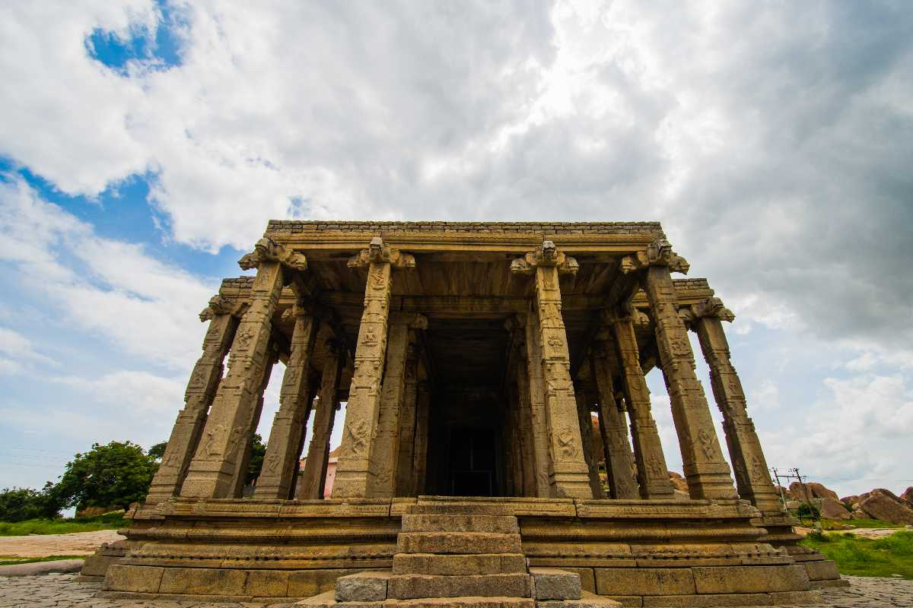
Kadalekalu Ganesh
15 feet monolithic statue of Lord Ganesha
One of the largest in the world
Belly of the deity is chiselled to look like Kadalekalu (Bengal gram)

Slide 24
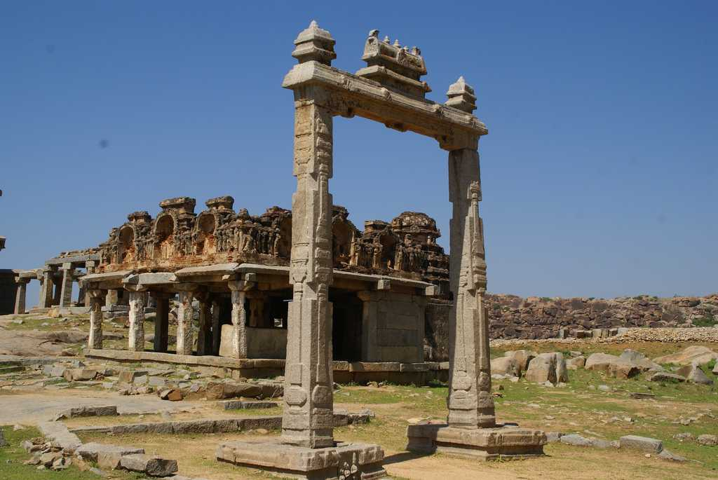
King’s Balance
Used to weigh the king with the royal jewels every year on special occasions.
The jewels were then donated to the temple priests

Slide 25
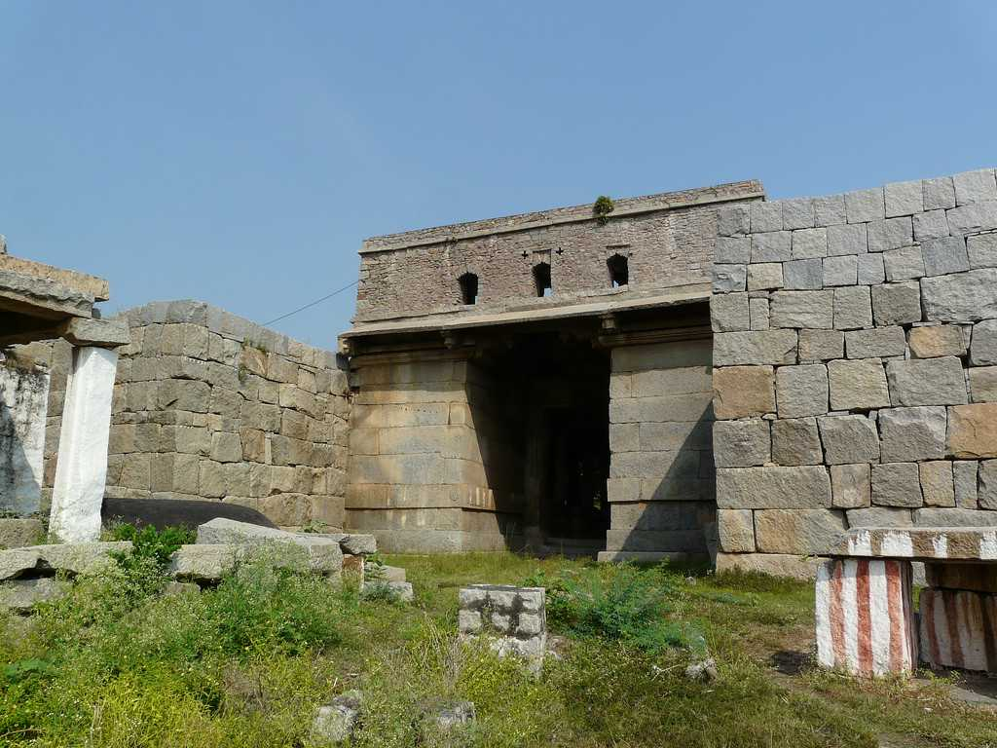
Riverside Ruins

Slide 26
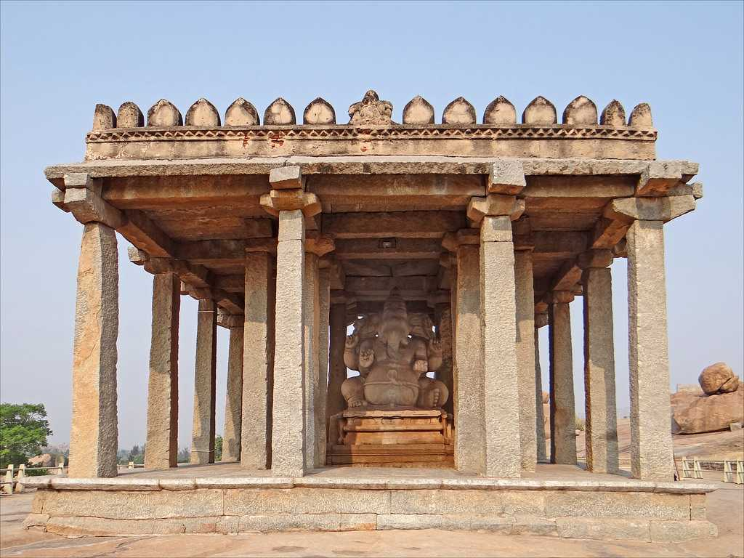
Sasivekalu Ganesh
Monolithic statue of Lord Ganesha
8 feet tall
In the memory of a Vijayanagara King – King Narasimha II.

Slide 27
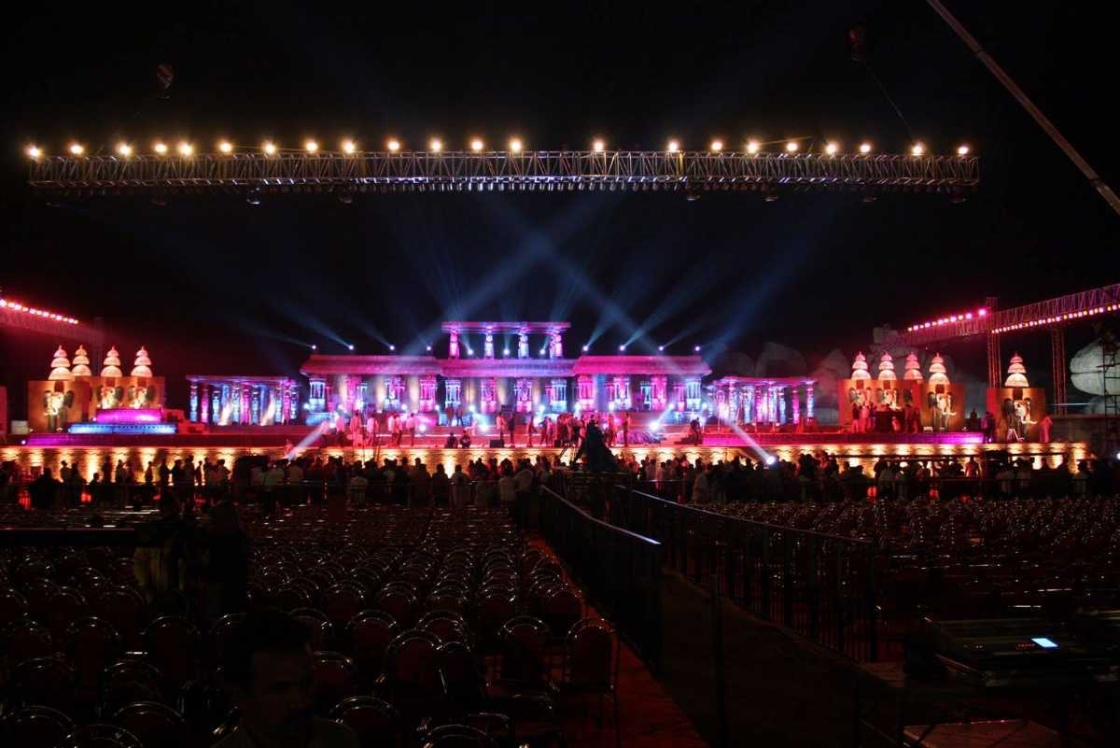
Hampi Utsav
Happens every November
also known as the Vijaya Utsav
Largest celebrations of the ancient Vijayanagar empire now Hampi.
Janapada Kalavahini, a concert of folk songs

Slide 28
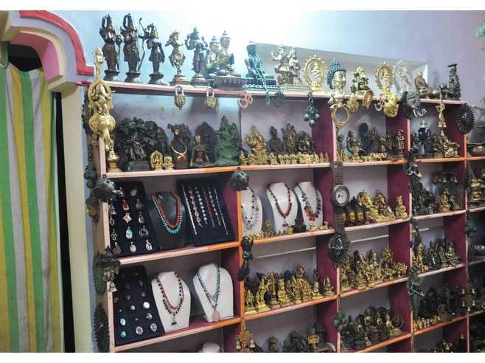
Shopping in Hampi
Stone carvings by local artists
Leather crafts
Musical instruments
etc

Slide 29
Thank you

Slide 30
